Slide 1
课件编辑说明
版本要求
本课件需用office2010及以上版本打开，如果您的电脑是office2007及以下版本或者WPS软件，可能会出现不可编辑的文档。
乱码问题
如您在使用过程中遇到公式不显示或者乱码的情况，可能是因为您的电脑缺少字体，请登录网站www.canpointgz.cn/faq下载。
联系我们
如您还有其他方面的问题，请登录网站www.canpointgz.cn/faq，点击“常见问题”，或致电010-58818058。

Slide 2

新高考版

Slide 3

第2讲
记人记事类

Slide 4
记人、叙事是记叙文书面表达常见的考查形式, 侧重点在人物介绍、事情描述上。高考对记叙文的考查主要以文字提纲和图画为主。写人物类记叙文主要包括外貌、性格、生平、职业、重要活动事件和贡献影响。写作时要围绕人物组织材料,要主题鲜明,突出重点,内容清楚和结构完整。叙事类记叙文多以事件为中心,以时间和空间为线索,按事件的发生、发展及结局展开,一般最后要表达对事件或活动的感想或看法。
专题导读

Slide 5
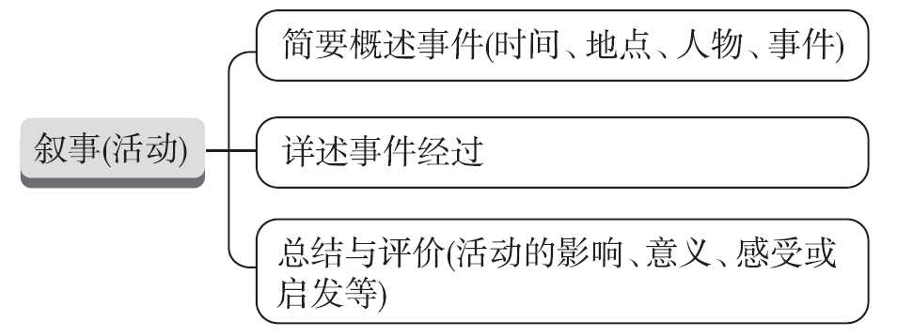
考点1 记人
【写作架构】
专题导读

Slide 6
【高考体验】
[2020·全国卷Ⅰ]
你校正在组织英语作文比赛。请以身边值得尊敬和爱戴的人为题, 写一篇短文参赛, 内容包括:
1. 人物简介;
2. 尊敬和爱戴的原因。
注意:1. 词数100左右;
2. 短文题目和首句已为你写好。
专题导读

Slide 7
The person I respect
There are many respectable people around us. ________________
____________________________________________________________________________________________________________________________________________________________________________________________________________________________________________________________________________________________
专题导读

Slide 8
[经典范文]
The person I respect
There are many respectable people around us. I have great admiration for Mr Sun, my English teacher, a middle-aged man of few words.
First, his helpfulness and kindness win him great popularity and a good reputation among us. Whatever difficulties we come across, he doesn't hesitate to come to our aid.
专题导读

Slide 9
In some sense, he is virtually a beacon of hope, encouraging us never to give up. On top of that, his rich experience and devotion to teaching not only give us easy access to professional knowledge but most importantly shape our character.
Such is Mr Sun that I have the highest respect for him.
专题导读

Slide 10
【提分句式】
精彩开头:开门见山,点明要介绍的人物
1. Among the outstanding figures in Chinese history, Zhu Geliang is my favourite, (在……方面有天赋) strategy in military.
2. The person I would like to interview most is Yang Liwei, who is not only the first Chinese to go to space but also one of the greatest astronauts in the world.
专题导读
who has a gift in

Slide 11
3. Old as Zhong Nanshan is, he fought bravely against COVID-19,
(做出了巨大的贡献) in the field of medicine.
正文佳句:人物详情(重要经历、事迹、成就等)
4. Optimistic and energetic, he often _____________________________
(积极参加) in after-class activities.
5. Whenever people around get into trouble, she is willing to help them, which makes her respected by all our neighbours.
making great contributions
专题导读
takes an active part

Slide 12
6. Not only__________________________________________________________ ____________________(爱因斯坦把他的一生都致力于科学研究) but also he cared for human beings' peace and development.
靓丽结尾:综合评价、感受等
7. He (树立了一个如此好的榜样) for us students that we all should learn from him.
did Einstein devote all his life to scientific research
专题导读
set so good an example

Slide 13
8. Her spirit inspires me and millions of other girls to live an independent life and be responsible for our own decisions.
9._____________________________________________________________________
(尽管她取得了如此巨大的成就), she remains modest and prudent.
Although she has gained such great achievements
专题导读

Slide 14
【模拟演练】
假定你是李华,你的英语老师要求你们写一篇英语短文介绍自己最敬佩的一位历史人物,内容包括:
1. 你最敬佩的人物;
2. 他/她所做的贡献;
3. 他/她对你的影响。
注意:写作词数应为80左右。
专题导读

Slide 15
One possible version:
A historical figure I admire most
There are many great people in the long history of the world, who have contributed a lot to our world. Among those, I admire Confucius most.
In the first place, Confucius was the first person to launch a private school in the history of China.
专题导读

Slide 16
Besides, as a teacher, he created influential teaching methods. Finally, he put forward lots of useful philosophical teachings which deeply affect our values, education, and daily life.
Confucius' saying “To learn without thinking is blindness; to think without learning is idleness” impresses me most. It helps me find the right way to learn and always reminds me to stay humble.
专题导读

Slide 17
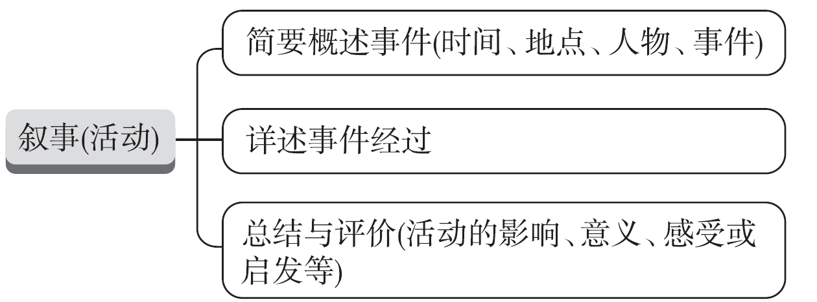
考点2 短文叙事
【写作架构】
专题导读

Slide 18
【高考体验】
[2020•全国卷Ⅱ]
上周末, 你和同学参加了一次采摘活动。请你为班级英语角写一篇短文, 介绍这次活动, 内容包括:
1. 农场情况;
2. 采摘过程;
3. 个人感受。
注意:1. 词数100左右;
2. 题目已为你写好。
专题导读

Slide 19
My weekend
____________________________________________________________________________________________________________________________________________________________________________________________________________________________________________________________________________________________
专题导读

Slide 20
[经典范文]
My weekend
To make our life colourful, we took part in an after-class activity—picking oranges last weekend in the countryside, and it was a fantastic experience.
In the morning we arrived at a farm with lots of big oranges hanging on the green trees. We walked through the trees and looked for oranges and picked them one by one.
专题导读

Slide 21
Meanwhile, I competed with my friends to see who gathered with the fastest speed and best quality. In the end, all of us not only gained many fresh and tasty fruits, but also learnt efficient ways to gather oranges well.
Personally, I was a little tired, but I was happy to learn that labour is important and meaningful.
专题导读

Slide 22
【提分句式】
精彩开头:简要概述事件(时间、地点、人物、事件)
1. In order to arouse students' interest in English, our school held an English Drama Competition in our school hall last Sunday afternoon, (结果证明这是一个巨大的成功).
2. Last week, our class participated in a farmwork programme in the suburbs.
专题导读
which turned out to be a great success

Slide 23
3. Last week, our school organized an activity named “Happiness to Family”, ____________________________________________
(结果是有意义的和难忘的).
正文佳句:详述事件经过
4. (一到达公园), what impressed me most was its fresh air and beautiful scenery.
5. (被美丽的景色吸引), we had a photo taken, capturing the precious moment forever.
which turned out to be
meaningful and unforgettable
专题导读
On arriving at the park
Attracted by the beautiful scenery

Slide 24
6. On arriving at the farm, what came into sight were varieties of fresh vegetables and fruit trees. Then we were divided into two groups for a picking competition. After one and a half hours' hard work, both groups harvested a lot, with our group being the winner.
靓丽结尾:总结与评价(活动的影响、意义、感受或启发等)
7. (尽管我们很累), we had a sense of achievement.
专题导读
Tired as we were

Slide 25
8. Thanks to the tour, not only have we improved our speaking skills, but we've also got a better understanding of British culture, ____________________________________________________________
______________________________________(这拓宽了我们的知识面,开阔了我们的视野).
9. Through this activity, I know bringing happiness to others can also make us happy. I hope our school can organize more activities like this.
which enlarged our knowledge and
broadened our horizons
专题导读

Slide 26
【模拟演练】
假定你是班长李华,上周日你组织你班同学到中山公园参加了学校志愿者服务俱乐部组织的环保活动,请你记叙此事。内容包括:
1. 活动内容:捡垃圾,发传单等;
2. 你对本次活动的感受。
注意:1. 词数不少于80;
2. 可适当加入细节,使内容充实、行文连贯。
参考词汇:志愿者服务俱乐部 the Voluntary Service Club 传单leaflet
专题导读

Slide 27
One possible version:
Last Sunday we participated in a meaningful activity organized by the Voluntary Service Club of our school to protect the natural environment of the city.
It was in the early morning that we went to Zhongshan Park by bus. Upon arrival, we got down to working in no time, busy but well-organized. Some gathered rubbish and threw it into the dustbins while some distributed leaflets to raise people's awareness of the damage littering can cause.
专题导读

Slide 28
At the end of the activity, it was apparent that everyone was extremely exhausted but we felt more than willing to do something for environmental protection.
The activity not only enables us to contribute to society by doing our bit but also makes us realize the importance of beautifying the environment and living in harmony with nature.
专题导读

